Slide 1
Uninformed Search
Md. Monarul Islam Mithu
Lecturer, Daffodil International University, CSE
B.Sc. In CSE, KUET
M.Sc. In CSE(Ongoing), BUET

Slide 2
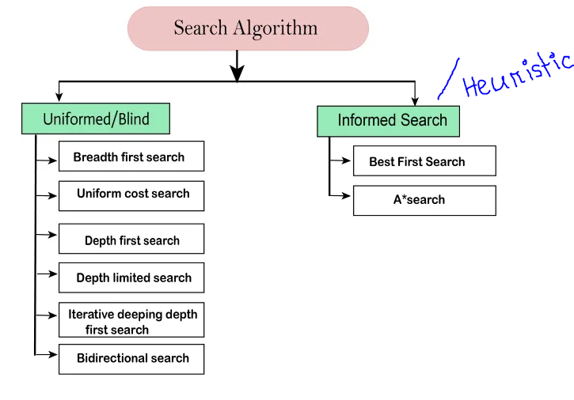
Searching Algorithms

Slide 3
Uninformed Search
Also known as Blind Search.
No additional information is used.
They do not use information about the distance or cost to reach the goal.
They explore all possible states or paths in a predetermined order.

Slide 4
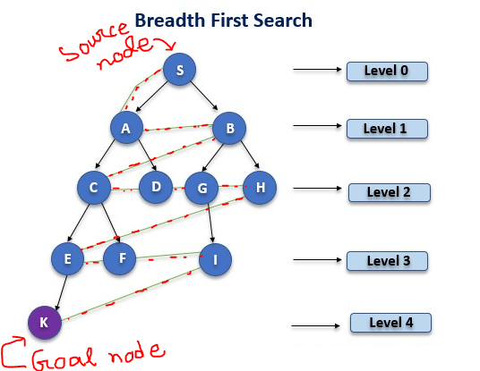
BFS (Breadth First Search)

Slide 5
BFS (Breadth First Search)
BFS is a search operation for finding the nodes in a tree/graph.
The algorithm works breadthwise and traverses to find the desired node in a tree.
Use Queue data structure.
It starts searching operation from the root nodes and expands the successor nodes at that level.

Slide 6
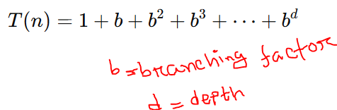
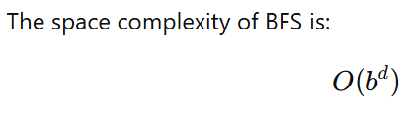
BFS (Breadth First Search)
Time Complexity of BFS is expressed as

Slide 7
BFS (Breadth First Search)
Think: When BFS will win?
Case1: Goal node is close to the root node.
Case2: Goal node is far than the root node.

Slide 8
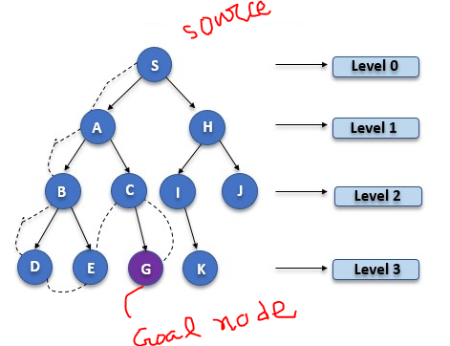
DFS (Depth First Search)

Slide 9
DFS (Depth First Search)
It traverses the graph or a tree depth-wise.
The DFS uses the stack for its implementation.
DFS requires very less memory as it only needs to store a stack of the nodes on the path from root node to the current node.

Slide 10
Homework
Disadvantages BFS and DFS???

Slide 11
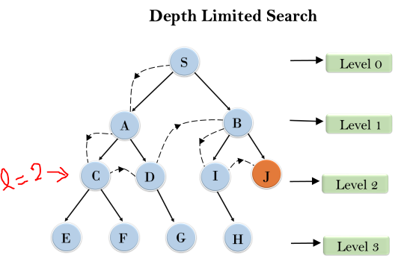
Depth Limited Search(DLS)

Slide 12
Depth Limited Search(DLS)
Variant of DFS but bounded by limited search.
Depth-limited search can solve the drawback of the infinite path in the Depth-first search. [infinite path—In Graph]
Time savings: It avoids the overhead of exploring irrelevant paths that are too deep.
Memory savings: It reduces the maximum stack depth in the recursion, making it less likely to run out of memory compared to unlimited DFS.

Slide 13
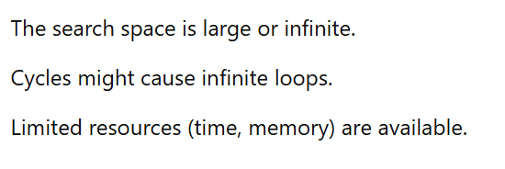
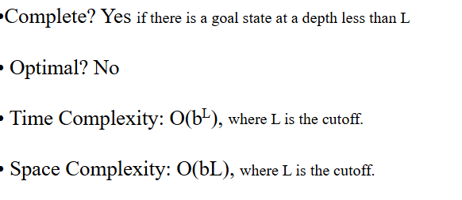
When you chose???—Depth Limited Search

Slide 14
Depth Limited Search(DLS)
Cutoff failure value??Solution??

Slide 15
UCS(Uniform Cost Search)
This algorithm comes into play when a different cost is available for each edge.
The primary goal of the uniform-cost search is to find a path to the goal node which has the lowest cumulative cost.
Uniform-cost search expands nodes according to their path costs form the root node.
A uniform-cost search algorithm is implemented by the priority queue.

Slide 16
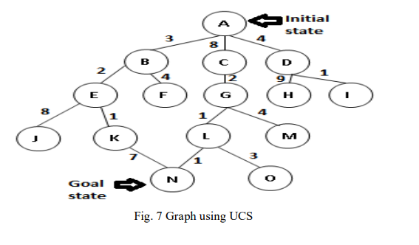
UCS(Uniform Cost Search)

Slide 17
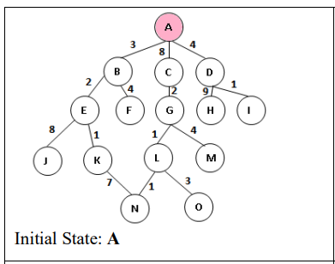
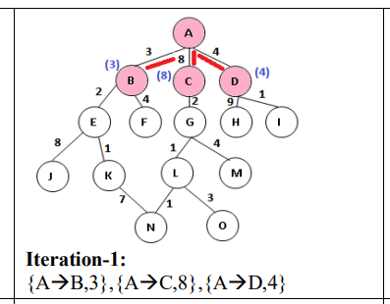
UCS(Uniform Cost Search)

Slide 18
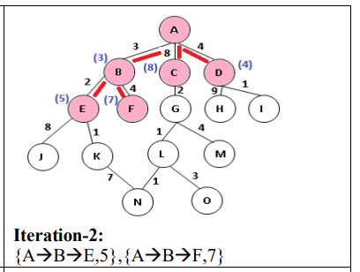
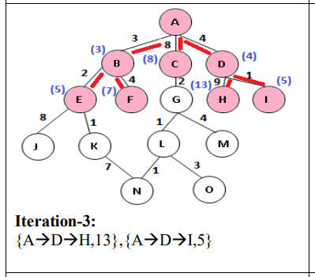
UCS(Uniform Cost Search)

Slide 19
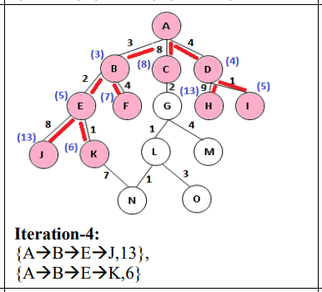
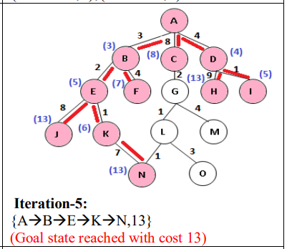
UCS(Uniform Cost Search)

Slide 20
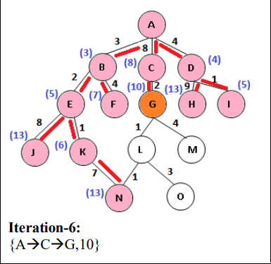
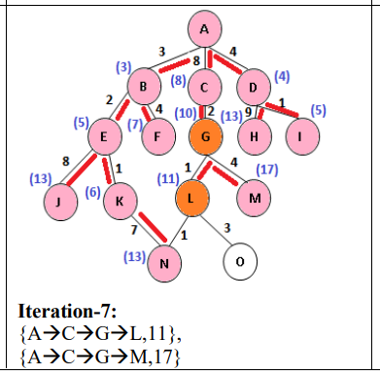
UCS(Uniform Cost Search)

Slide 21
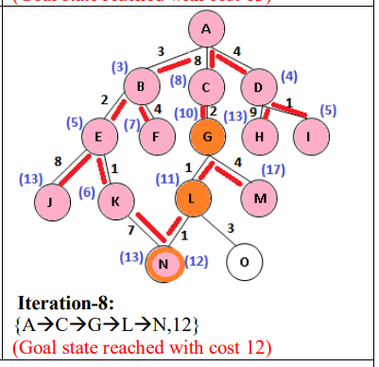
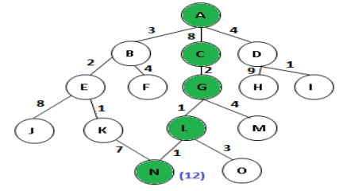
UCS(Uniform Cost Search)

Slide 22
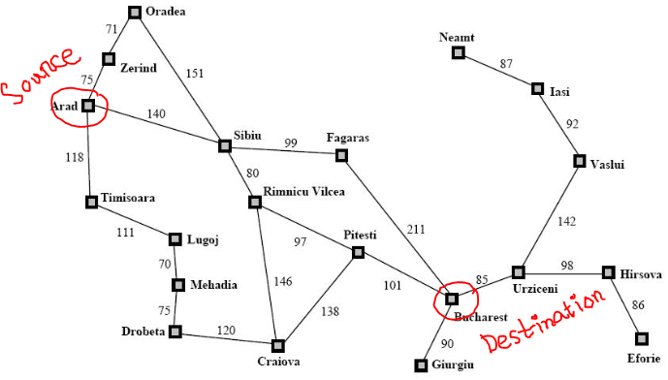
Homework [Apply UCS]

Slide 23
The End

